Slide 1
Hello Hello #PyConCo2020

Slide 2





Angelica Landazabal
Computer Science Engineering and a technology lover. (Karateka too)
I like the development of web applications, marketing and, of course, data analysis ;)
It motivates me to continue learning about various IT topics, personal / professional growth and helping others so they are also motivated to learn.
"Keep going" is my motto :)
angelica.informatik@gmail.com
ALandazabal
@ALandazabal15

Slide 3

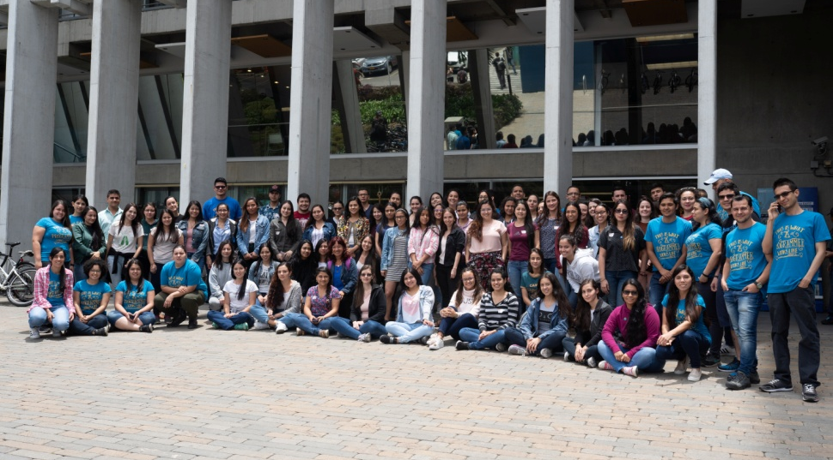

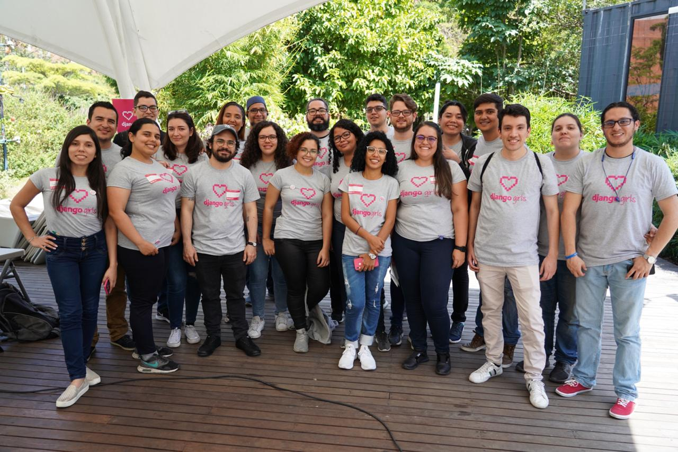

Slide 4






Slide 5


Slide 6


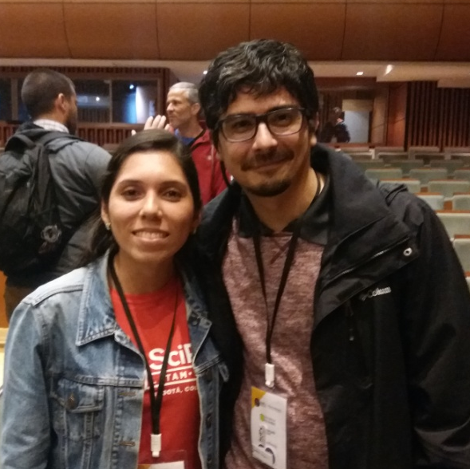

Lindsey Heagy
Travis Oliphant
Damián Avila
https://www.youtube.com/channel/UClb88lwUvlFikmhTzVGsVGA/featured

Slide 7
"Applying sentiment analysis to your social network"
What is Sentiment Analysis?

Slide 8
Objectives:
Understand What is Natural Language Processing y which are its applications.
Extract data from a Social Network.
Cleaning the data extracted.
Apply the Sentiment Analysis technique to 2 sets of data (Spanish - English).
Show data processed.

Slide 9



What will we need?
https://github.com/ALandazabal/Python-Pereira---Analisis-de-Sentimiento

Slide 10
Natural Languaje Processing (NLP )
Is the study that it try to understand, analyze, interpret and obtain mean of human languaje with a computer to will be used in data science, AI and linguistics.
The main idea is perceive of a set of words the intention of its creator.

Slide 11
NLP applications:
Translation: It is the most used application because it allows you to understand more quickly the text written in another language.
Automatic summarization: the idea is get a reduced version of a text created by extraction or abstraction.
Chatbots: A system capable of having a coherent conversation with a human about a specific topic.

Slide 12
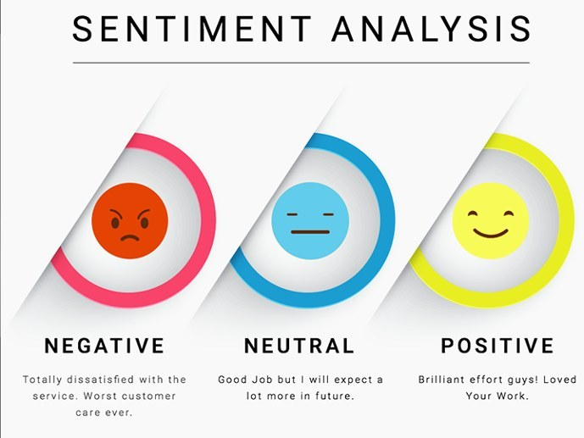
Sentiment Analysis: Identify subjective information in texts as judgments or opinions used for companies and famous people that want to be aware of their reputation on the internet.

Slide 13
Steps for Sentiment Analysis:

Slide 14

Step 1: Extract Data
Social Network: Twitter
Twitter is what is happening in the world and what people are talking about at the moment. You can access Twitter on the Web or from your mobile device.

Slide 15
Step 1: Extract Data
API Twitter: Twitter provides companies, developers and users programmatic access to data through its API (application programming interface).
You should be a twitter developer account and create an app to request the access tokens.
Note: We only access public information

Slide 16
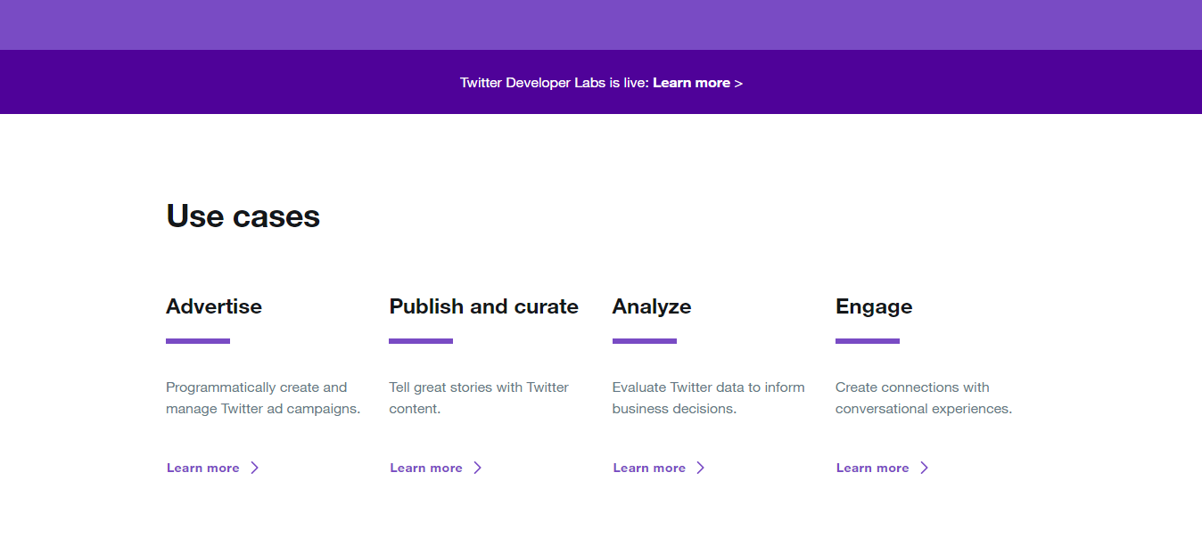

Step 1: Extract Data
https://developer.twitter.com/en.html

Slide 17

Step 1: Extract Data
Tweepy: An easy-to-use Python library for accessing the Twitter API.
Install with :
Csv: Is a Python module for creating CSV files.
Install with :
pip install tweepy
pip install python-csv

Slide 18
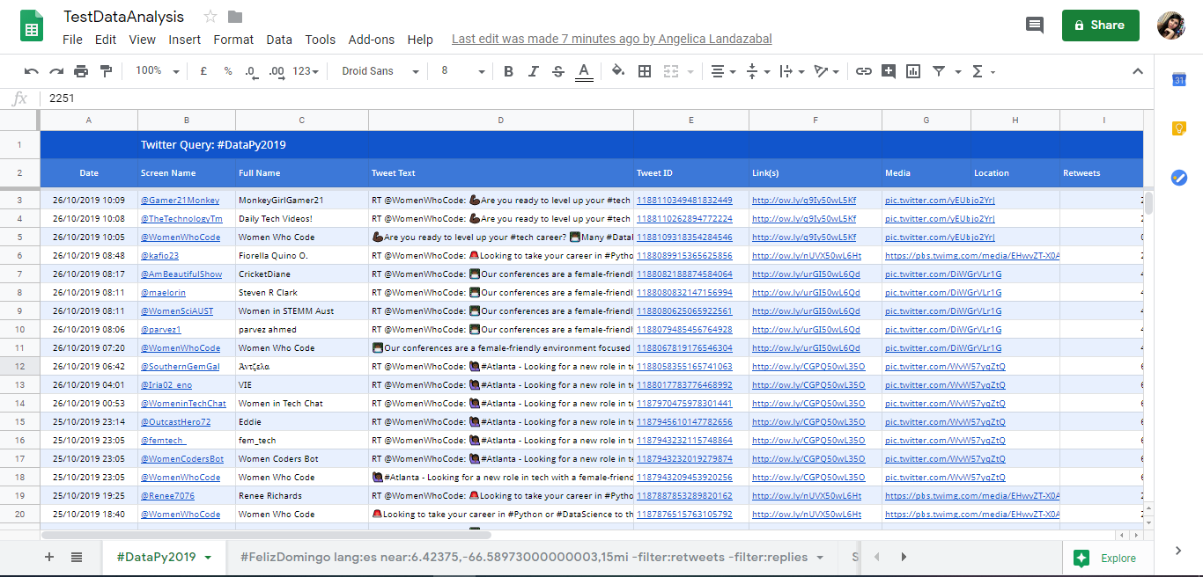

Step 1: Extract Data
Twitter Archiver: is an Add-ons in Drive Spreadsheet help us to extract data of twitter with the parameters given.
https://docs.google.com/spreadsheets/d/1tUlLulV5Y-yWivYHnLw4zWh7DEKDCC7DNVbtqPXEnZU/edit?usp=sharing

Slide 19

Step 1: Extract Data
Facebook-Scraper: Scrape Facebook public pages without an API key. Inspired by twitter-scraper.
Install with :
pip install facebook-scraper

Slide 20
Step 2: Load Data
Pandas: Powerful data structures for data analysis, time series, and statistics.
Install with :
NLTK: The Natural Language Toolkit (NLTK) is a Python package for natural language processing.
Install with :
pip install pandas
pip install nltk

Slide 21
Step 3: Clean Data
String: contains some constants, utility function, and classes for string manipulation.
Install with :
Re: This module provides regular expression matching operations similar to those found in Perl.
Install with :
Emoji: The entire set of Emoji codes as defined by the unicode consortium is supported in addition to a bunch of aliases.
Install with :
pip install strings
pip install re
pip install emoji

Slide 22

Objectives:
Understand What is Natural Language Processing y which are its applications.
Extract data from a Social Network.
Cleaning the data extracted.
Apply the Sentiment Analysis technique to 2 sets of data (Spanish - English).
Show data processed.

Slide 23
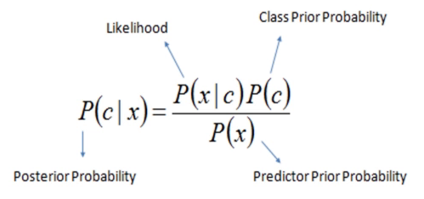
Step 4: Processing Data
,
Naive Bayes: It is a classification and prediction technique that constructs models to determine what size is the possibility in which a set of data originates certain results..

Slide 24




Step 4: Processing Data
,
Total | Positive |  | Negative
100 | 70 |  | 30
Learn | 55 | 0,78 | 5 | 0,16
Patterns | 40 | 0,57 | 10 | 0,33
… | … | … | … | …
Learn and Patterns | 31 | 0,44 | 1,5 | 0,05
$$P\left(Pos \right|\text{Learn} \text{and} \text{Patterns})=$$
$$\frac{31}{31+1,5}=0,95⇒95\%$$
$$P\left(Neg \right|\text{Learn} \text{and} \text{Patterns})=$$
$$\frac{1,5}{31+1,5}=0,05⇒5\%$$

Slide 25
Step 4: Processing Data
,
Bag of word: It is a mathematical representation of the testing data set. This has all the unique words of a document and the occurs frequency of each one.
 | it | is | puppy | cat | pen | a | this
it is a puppy | 1 | 1 | 1 | 0 | 0 | 1 | 0
it is a kitten | 1 | 1 | 0 | 0 | 0 | 1 | 0
it is a cat | 1 | 1 | 0 | 1 | 0 | 1 | 0
that is a dog and this is a pen | 0 | 2 | 0 | 0 | 1 | 2 | 1

Slide 26
Step 5: Show Data
Matplotlib: is a Python 2D plotting library which produces publication quality figures in a variety of hardcopy formats and interactive environments across platforms.
Install with:
WordCloud: This tool will be quite handy for exploring text data and making your report more lively.
Install with:
pip install matplotlib
pip install wordcloud

Slide 27
Processing Data (English text)
Textblob: It provides a consistent API for diving into common NLP tasks such as part-of-speech tagging, noun phrase extraction, sentiment analysis, and more.
Sentiment Analysis returns two values:
Polarity: float which lies in the range of [-1,1] where 1 means positive statement and -1 means a negative statement.
Subjectivity: Subjective sentences generally refer to personal opinion. Subjectivity is also a float which lies in the range of [0,1].
Install with:
pip install textblob

Slide 28
Objectives:
Understand What is Natural Language Processing y which are its applications.
Extract data from a Social Network.
Cleaning the data extracted.
Apply the Sentiment Analysis technique to 2 sets of data (Spanish - English).
Show data processed.

Slide 29
Use cases of Sentimental Analysis
Brand monitoring
Competitive research
Flame detection and customer service prioritization
Product analysis
Market research and insights into industry trends
Workforce analytics/employee engagement monitoring

Slide 30
Sources
The Definitive Guide to Natural Language Processing : https://monkeylearn.com/blog/definitive-guide-natural-language-processing/
API Twitter: https: //developer.twitter.com/
Jupyter Notebook: https://jupyter.org/
Excel files with python: https://xlsxwriter.readthedocs.io/
Tweepy Library: https://www.tweepy.org/
Pandas: https: //pandas.pydata.org/
NLTK: https: //www.nltk.org/
Re: https: //docs.python.org/3/library/re.html

Slide 31
Sources
String module: https://www.journaldev.com/23788/python-string-module
TextBlob: https: //textblob.readthedocs.io/en/dev/
Matplotlib: https://matplotlib.org/
WordCloud: https://www.datacamp.com/community/tutorials/wordcloud-python
Sentiment Analysis: Types, Tools and Use Cases: https://www.altexsoft.com/blog/business/sentiment-analysis-types-tools-and-use-cases/

Slide 32



“Las personas mienten, los datos no”
PlatziConf 2019
angelica.informatik@gmail.com
ALandazabal
@ALandazabal15

